Slide 1
Analyses of Algorithms
Dr. Sifat Momen

Slide 2
Analyzing Algorithms & Random Access Machine (RAM) model
Analyzing an algorithm means predicting resources that the algorithm requires.
Resources can include memory, communication bandwidth, computer hardware, ....
However, most often it is the computational time we want to measure.
Generally, by analyzing several candidate algorithms for a problem, we can identify a most efficient one.
Before we can analyze an algorithm, we need to have a model of the implementation technology against which an algorithm will be evaluated.
For the rest of this course, we will use random-access machine (RAM) model of computation as our implementation technology.

Slide 3
Random-Access Machine (RAM) model
One processor
Instructions are executed one after another. No concurrent operations
The following instructions takes a constant amount of time:
Arithmetic: add, subtract, divide, multiply, remainder, floor, ceiling. Also shift-left /shift-right
Data movement: load, store, copy
Control: conditional/unconditional branch, subroutine call and return
RAM uses integer and floating-point types

Slide 4
Time complexity analysis – asymptotic notations
In this lesson, we will learn the concept of asymptotic notation as a way to classify running time of algorithms into some generic and broad classes.

Slide 5
Time complexity analysis – asymptotic notations
Algorithm 1: T(n) = 5n² + 7
Algorithm 2: T(n) = 17n² + 6n + 8
These functions are corresponding to the model machines but we want some functions or some representation which is true irrespective of the machine and still gives us the idea about the rate of growth of time.
Random Access Machine

Slide 6
Time complexity analysis – asymptotic notations
Algorithm 1: T(n) = 5n² + 7
Algorithm 2: T(n) = 17n² + 6n + 8
n -> ∞
Lower order terms become insignificant
The multiplication quantifiers also become insignificant
So both the algorithms have quadratic rate of growth i.e. T(n) = O(n²).

Slide 7
Time complexity analysis – some general rules
We analyze time complexity for
Very large input size
Worst case scenario

Slide 8
Time complexity analysis – some general rules
Rules
Drop the lower order terms
Drop constant multipliers
And you will get the big-oh notation
T(n) = n³ + 2n² + 4n + 5
≈ n³
= O(n³)
T(n) = n⁴ + 5n³ + 8n² + 6n + 6 = O(n⁴)

Slide 9
Time complexity analysis – some general rules
Rule: Running time = Sum of all running time of all fragments.
int a;
a = 5; O(1)
a++;
for(i = 0; i <n; i++)
{
// simple statements O(n)
}
for(i=0; i<n; i++)
for(j=0; j<n; j++)
{
// simple statements
}
O(n²)

Slide 10
Time complexity analysis
function()
{
int a;
a = 5;
a++;
for(i = 0; i <n; i++)
{
// simple statements
}
for(i=0; i<n; i++)
for(j=0; j<n; j++)
{
// simple statements
}
O(1)
T(n) = O(1) + O(n) + O(n²)
For large values of n,
O(1) and O(n) would be insignificant
∴ T(n) = O(n²)
O(n)
O(n²)

Slide 11
What is the time complexity of this function?
function()
{
if(some condition)
{
for(i = 0; i <n; i++)
{
// simple statements
}
}
else
{
for(i=0; i<n; i++)
for(j=0; j<n; j++)
{
// simple statements
}
}

Slide 12
Now let’s analyze a code
http://www.programmingsimplified.com/c/source-code/c-program-bubble-sort

Slide 13
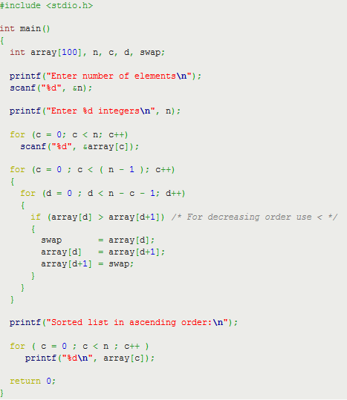

Slide 14
Singly Linked List
Operation | Without tail | With tail
Add Node At Front | O(1) | O(1)
Add Node At End | O(n) | O(1)
Add Node At A Particular Position | O(n) | O(n)
Search an item | O(n) | O(n)
Delete Front Node | O(1) | O(1)
Delete Last Node | O(n) | O(n)
Delete a Node at a Particular Position | O(n) | O(n)
Return first node | O(1) | O(1)
Return last node | O(n) | O(1)
Add node before a node | O(n) | O(n)
Add node after a node | O(1) | O(1)

